Slide 1
Subatomic Particles

Slide 2
What are subatomic particles?
The particles that make up an atom. These include many different parts, but here are the ones that we will be focusing on in Science 8
In the Nucleus
Protons
Neutrons
Surrounding the Nucleus
Electrons
See New textbook page 162

Slide 3
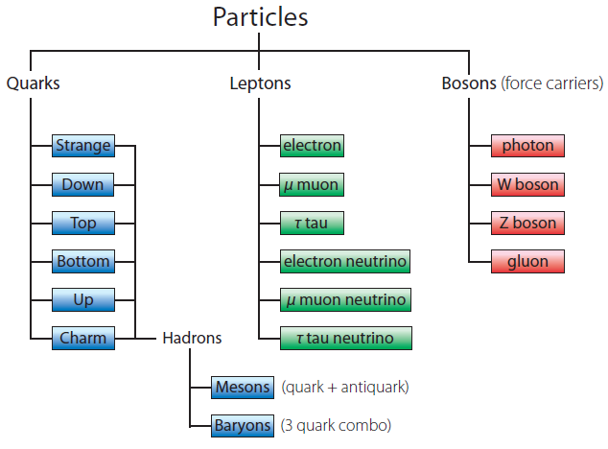
Elementary/Fundamental Particles
These are particles whose structure is unknown. Thus, we do not know if they are made up of other types of particles.
They make up other particles
Examples: quarks and leptons
See New textbook page 164

Slide 4
Quarks
There are six types of quarks that we know of. With different combinations, we make protons and neutrons.
The quarks are held together with particles called gluons that act as glue
See New textbook page 164

Slide 5
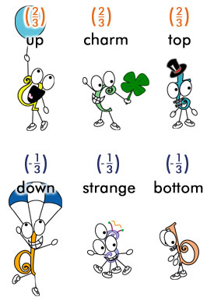
Quarks Con’t

Slide 6
Leptons
Leptons are another fundamental particle that respond only to electromagnetic, weak, and gravitational forces and do not take part in strong interactions.
There are six leptons, three of which have electrical charge and three of which do not so they are neutral.
The best known lepton is the electron(e⁻).
See New textbook page 165

Slide 7
Homework ☺
Read Page 162-166
Copy out chart called “The Nuclear Force” on page 163 into your notes
Answer “Before you leave this page” Questions
Pg. 163 #1-4
Pg 165 #1-2
Pg. 167 #1-11

